Slide 1
Board Implementation of DNN
Diandian Chen
May 30, 2018

Slide 2
Block Diagram
Training data sent from PC via UART
“IOExpansion” extracts data bytes from bit stream from UART RX pin
“grouper” collects bytes from “IOExpansion” into 256-bit data
When new 256-bit data is ready, 15MHz gated clock is enabled and grouper offer this 256-bit input to DNN
FPGA (board_noDDR_top.sv)
PC
IOExpansion_uart.v
dwOut[7:0]
grouper.v
group_data_out[255:0]
DNN_top.sv
Realterm.exe
UART
rx_data_rdy
group_ready
actL_alln
reg
clk_wiz_15
clk_100MHz
en
clk_i
clk_15MHz
BUFGCE
clk_15MHz_gated
LED

Slide 3
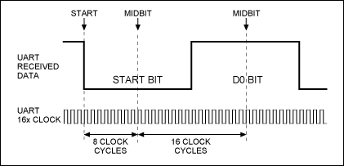
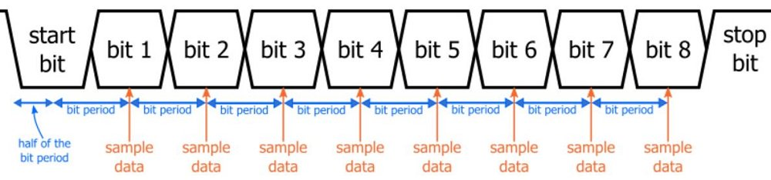
UART
Simple protocol, line stays high when IDLE, each transmission has 1 LOW START bit, normally 8 data bits, optional parity bit and normally 1 HIGH STOP bit (high active)
Serial transmission, no clock signal aside or embedded. Normally 16x or 32x oversampling on receiver side is needed. Oversampling clock is generated from Baud Rate and Receiver Clock
Two sides should agree on the same Baud Rate and content of bits
oversampling clock generation is in uart_baud_gen.v
state machine of this is in uart_rx_ctrl.v

Slide 4
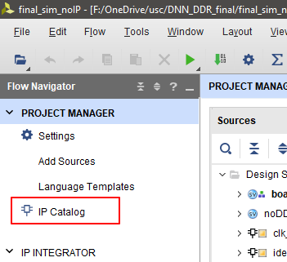
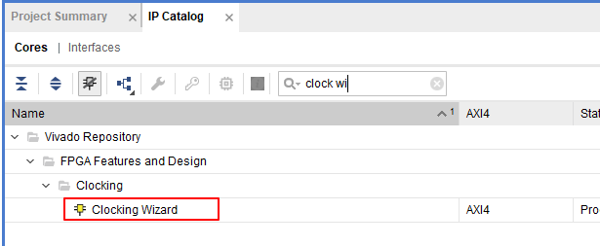
Clock Wizard
Clock Wizard is an Xilinx IP that uses one input clock to generate clocks with specified frequency and phase
It is used in this design to generate the 15 MHz clock for DNN
Find “Clock Wizard” in IP Catalog on the left side

Slide 5
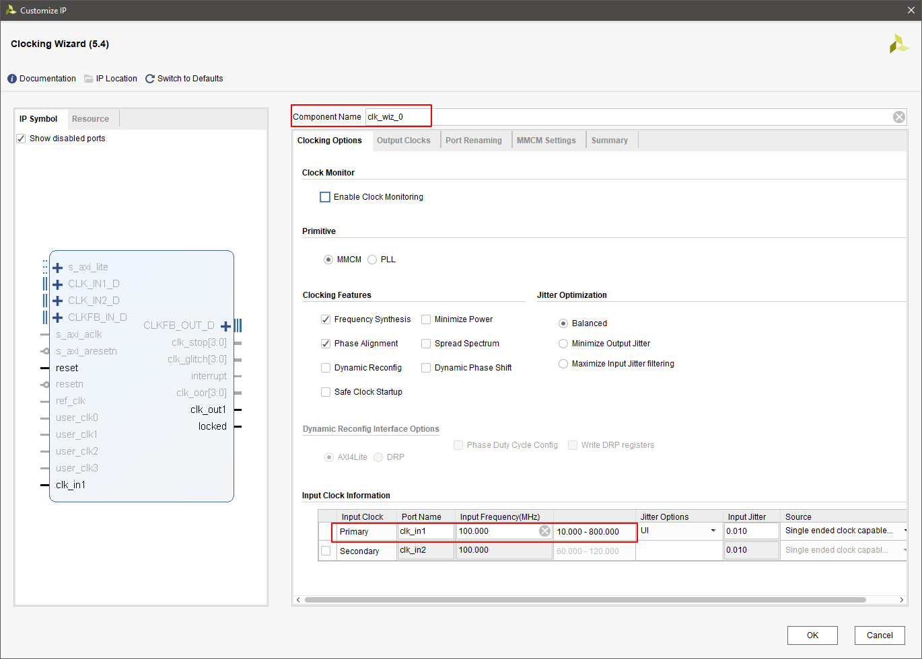
Clock Wizard
After specifying the input clock (in this design buffered clock from clock pin), we can go to the second tab “Output Clocks” and specify wanted clock configuration
Use specified “Component Name” to do instantiation of this IP

Slide 6
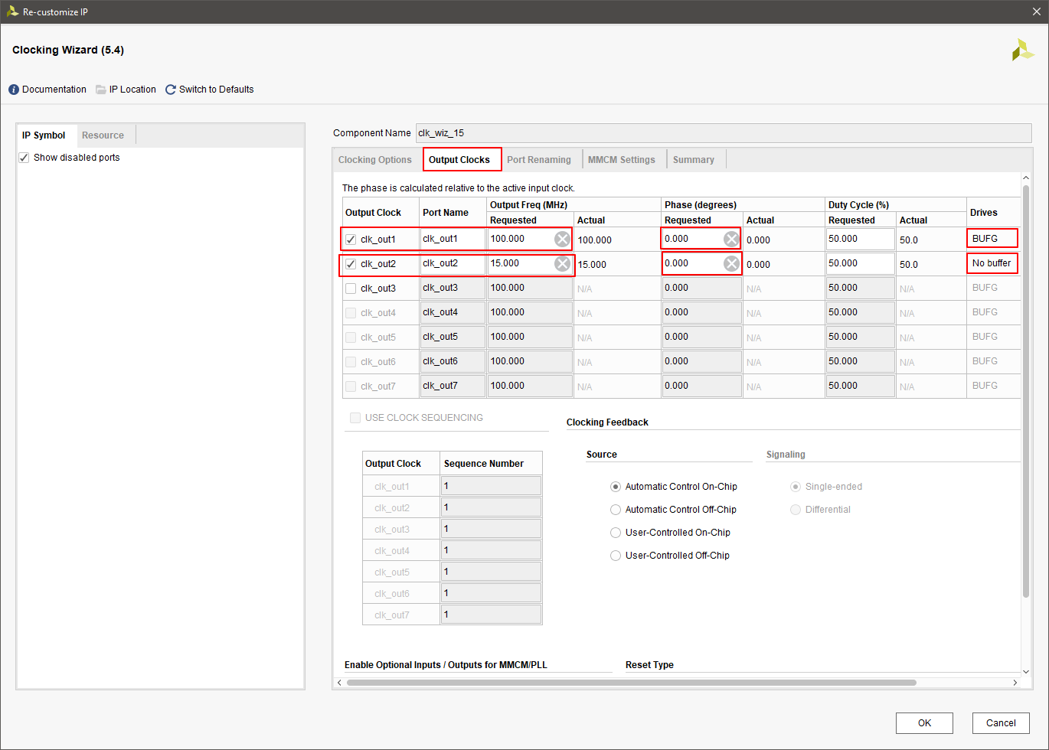
Clock Wizard
After specifying the input clock (in this design buffered clock from clock pin), we can go to the second tab “Output Clocks” and specify wanted clock configuration
Use specified “Component Name” to do instantiation of this IP

Slide 7
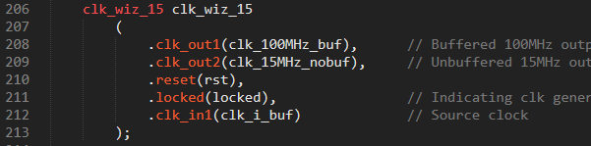
Clock Wizard
After specifying the input clock (in this design buffered clock from clock pin), we can go to the second tab “Output Clocks” and specify wanted clock configuration
Use specified “Component Name” to do instantiation of this IP

Slide 8
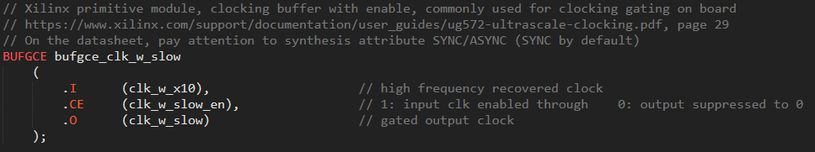
About BUFGCE
BUFGCE is Xilinx primitive that can be directly coded and recognized for simulation & synthesis in Xilinx tools (like VIVADO, ISE), and get mapped to corresponding hardware resources on board. There’re many other primitives like BUFG, IBUF, OBUF, FDCE...
Such primitives can be simply instantiated as below. And the simulation result shows how its behavior is similar to “clock gating with a latch” after its output stables (at positive edge of input clock, if enable signal is low, then output clock stays low for the cycle after this edge; if enable signal is high, then output clock is a replica of input clock for the cycle after this edge

Slide 9
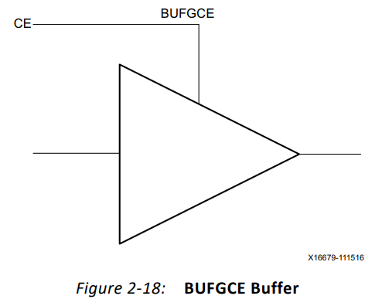
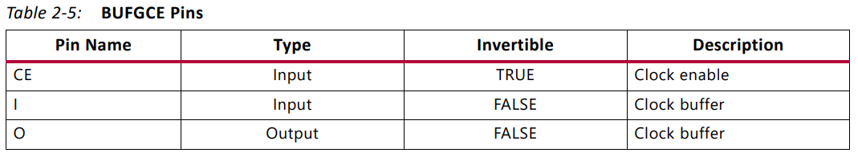
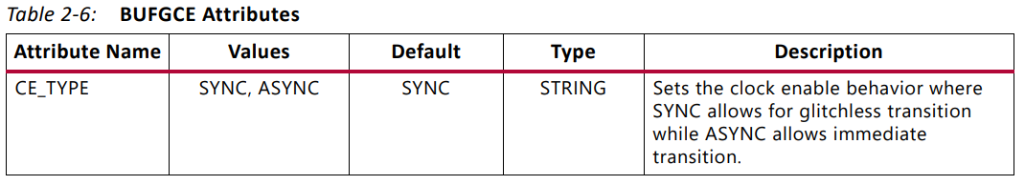
BUFGCE
Clock buffer with an enable line, commonly used on FPGA for clock gating
Two options for synthesis: SYNC (default) and ASYNC. When synthesized in SYNC mode, it behaves similarly to “gated clocking with a latch” covered in EE560
Official document: https://www.xilinx.com/support/documentation/user_guides/ug572-ultrascale-clocking.pdf, page 29
If interested in more discussion on how to do clock gating on FPGA, check this for reference: https://forums.xilinx.com/t5/Timing-Analysis/FPGA-clock-gating-implementation/td-p/548555

Slide 10
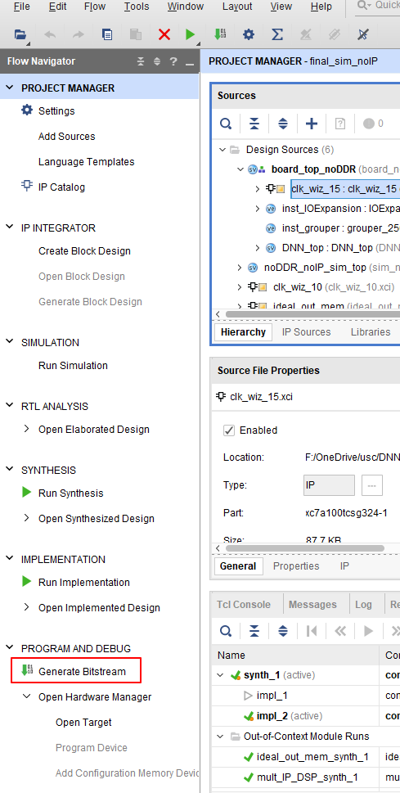
How to Play with the Board
After all the debug work is done, clock “Generate Bitstream” to let it go through synthesis to implementation to bit file generation
Reports of Resources and Timing are available in synthesis report and implementation report

Slide 11
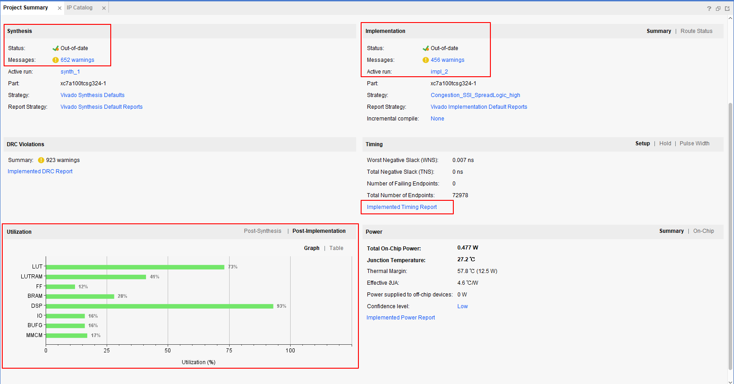
How to Play with the Board

Slide 12
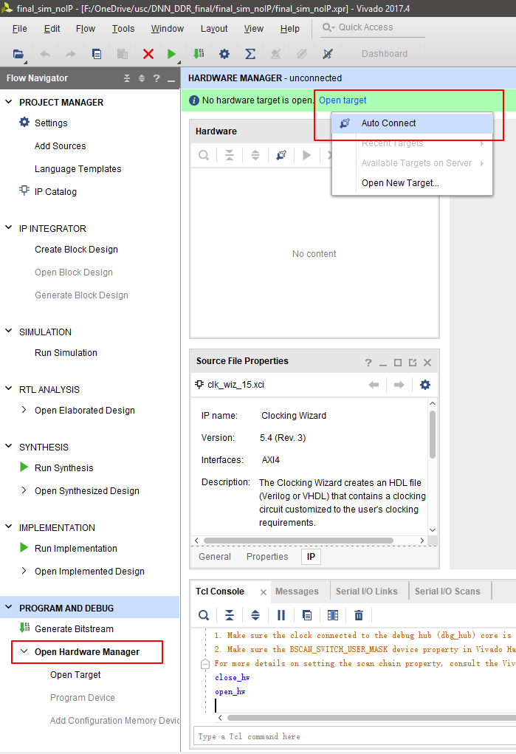
How to Play with the Board
After bit file is successfully generated, connect the board to PC using given cable, and power on the board
Click “Open Hardware Manager” and Open Target -> Auto Connect

Slide 13
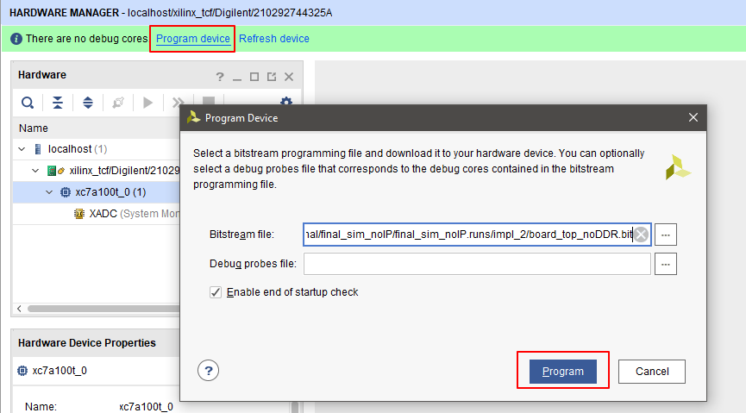
How to Play with the Board
Now the board should be automatically recognized by VIVADO
Click Program Device and program the board with the latest bit file generated just now
Then the bit file will be downloaded into the board

Slide 14
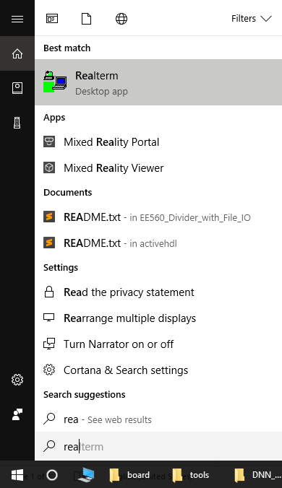
How to Play with the Board
After downloading bit file onto the board, open up PC serial transmission assistance app Realterm (MAC should have similar app as well). This is the windows app we use to transmit training data from PC to board via UART
https://sourceforge.net/projects/realterm/

Slide 15
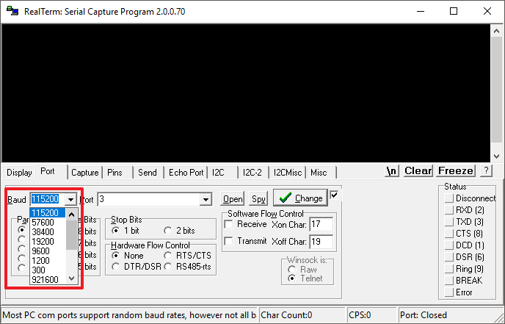
How to Play with the Board
In the app you only need to change the Baud Rate to the same as set in the code (in board_noDDR.v, line 27, parameter BAUDRATE). Other protocol configuration can be simply left default

Slide 16
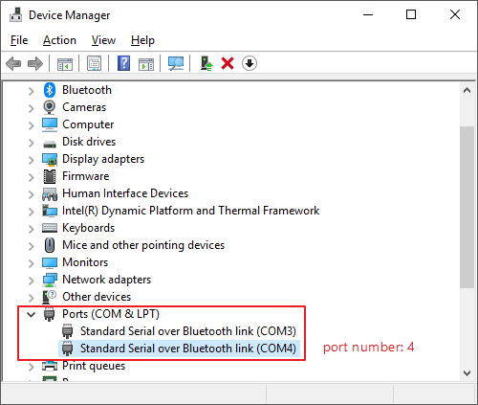
How to Play with the Board
Then set the transmission port number connected to the board. In Windows OS, go to Device Manager and you can check number of the newly connected port

Slide 17
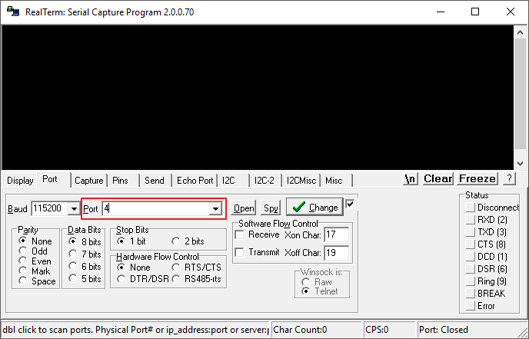
How to Play with the Board
Then set the correct port number Realterm is going to put data through

Slide 18
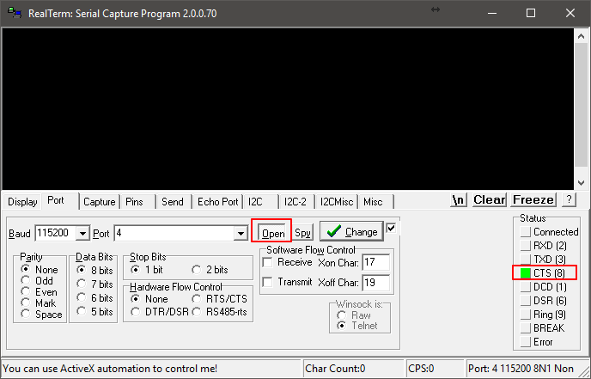
How to Play with the Board
Once port is correctly set and bit file containing UART module is downloaded onto board, open the port and you should see connection signal glow green

Slide 19
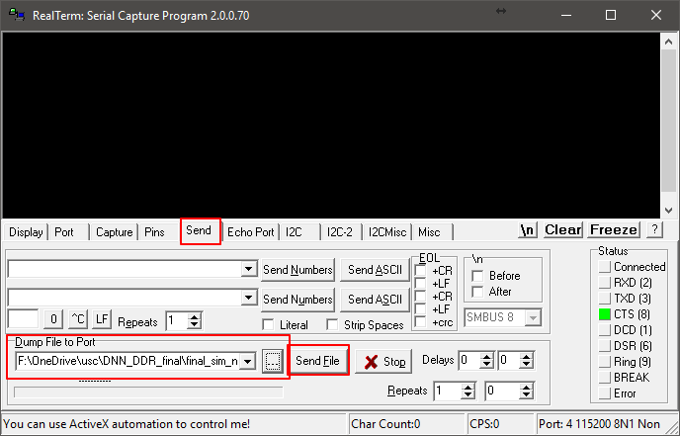
How to Play with the Board
Go to Send tab and browse for our training data input file
Click Send File and you will see the progress of sending current file into the board. Meanwhile TX led on board (should mean Transmitter of connected device) will keep blinking

Slide 20
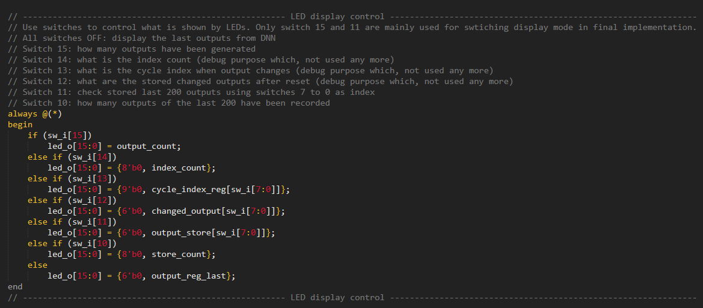
How to Play with the Board
Play with the switches and check what’s happening

